Slide 1
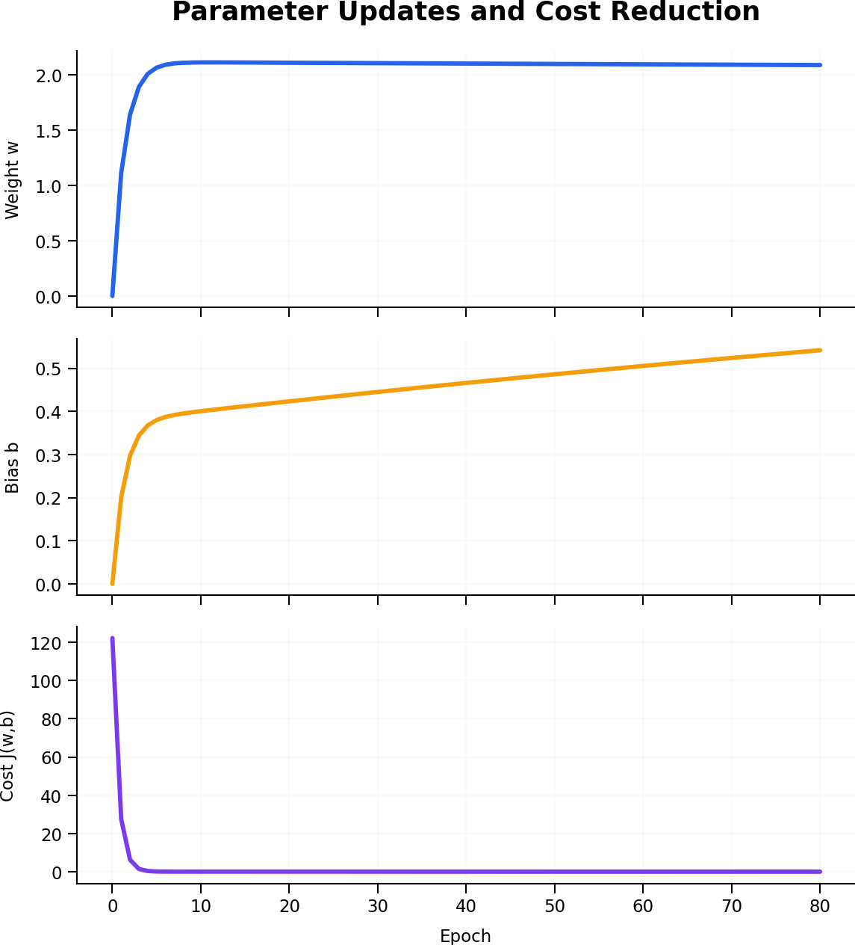
Gradient Descent in Linear Regression
Weight, bias, and cost function graphs across training epochs
ŷ = wx + b
Learning rate α = 0.01 | 80 epochs
Notes:
[Sources]
- Graphs use a synthetic eight-point teaching dataset and original gradient-descent calculations prepared for this presentation.
[/Sources]
Introduce the three linked views: parameters change while the cost falls.

Slide 2
How the Three Graphs Are Connected
Each epoch uses the gradients to update parameters and then recalculates the cost.
Weight w
Changes the slope of the prediction line.
Bias b
Changes the vertical position of the line.
Cost J(w,b)
Measures mean squared prediction error.
Notes:
[Sources]
- Graphs use a synthetic eight-point teaching dataset and original gradient-descent calculations prepared for this presentation.
[/Sources]
Read vertically at any epoch: the top and middle graphs give model parameters; the bottom graph gives the resulting error.

Slide 3
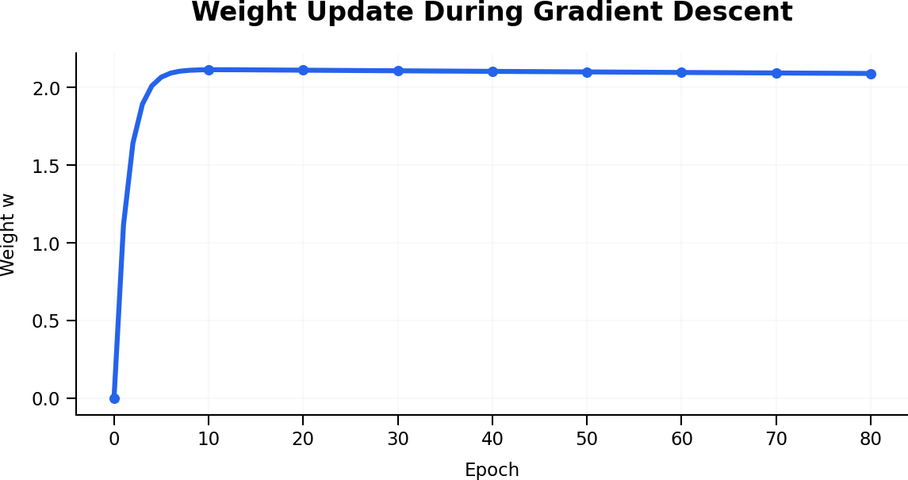
Weight Update Graph
The weight rises quickly and then changes more gradually.
Initial value
w = 0.0000
After 5 epochs
w = 2.0672
After 80 epochs
w = 2.0908
Notes:
[Sources]
- Graphs use a synthetic eight-point teaching dataset and original gradient-descent calculations prepared for this presentation.
[/Sources]
Explain that a large early gradient causes rapid movement. Near the minimum, the updates become smaller.

Slide 4
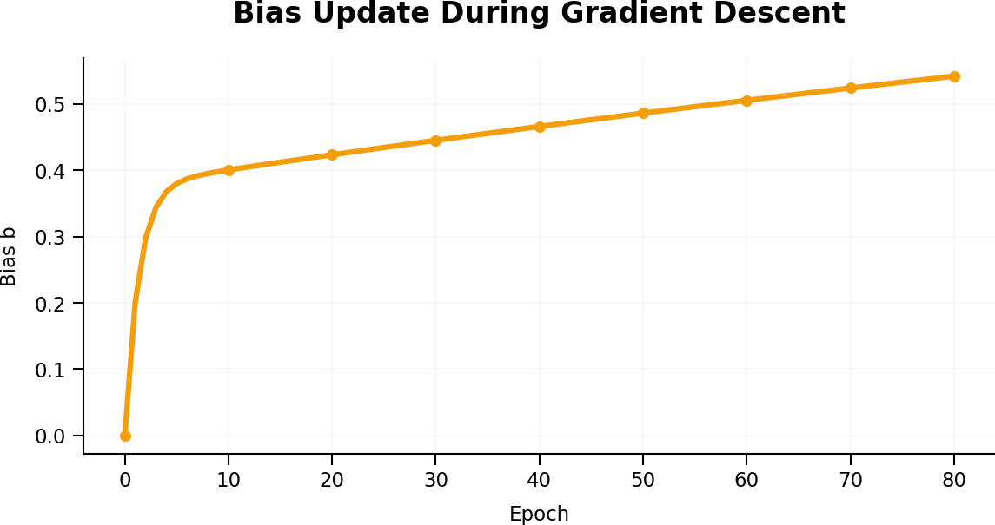
Bias Update Graph
The bias shifts the fitted line vertically during training.
Initial value
b = 0.0000
After 20 epochs
b = 0.4233
After 80 epochs
b = 0.5418
Notes:
[Sources]
- Graphs use a synthetic eight-point teaching dataset and original gradient-descent calculations prepared for this presentation.
[/Sources]
Unlike the weight, the bias continues to adjust slowly because both parameters jointly determine the loss.

Slide 5
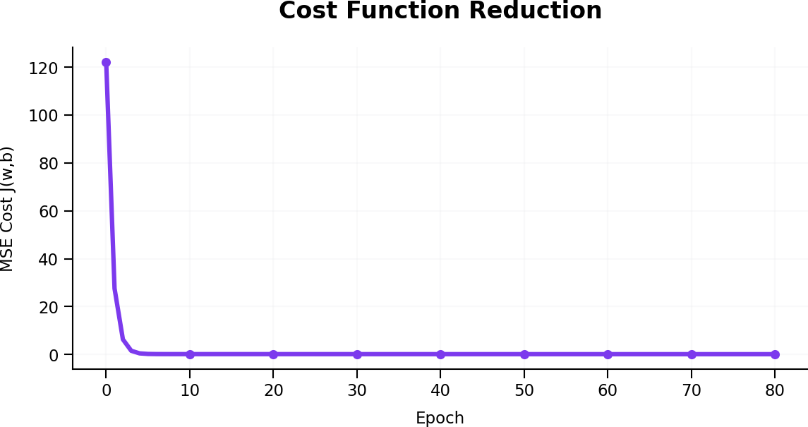
Cost Function Reduction
Mean Squared Error falls sharply during the first few updates.
Epoch 0
J = 122.1338
Epoch 2
J = 6.3355
Epoch 10
J = 0.1753
Epoch 80: J = 0.1457
The curve is nearly flat.
Notes:
[Sources]
- Graphs use a synthetic eight-point teaching dataset and original gradient-descent calculations prepared for this presentation.
[/Sources]
Use the steep initial fall to show fast learning. The later flat region indicates diminishing improvements, not necessarily zero error.

Slide 6
Parameter and Cost Values by Epoch
Numerical checkpoints corresponding to the three graphs.
Epoch | Weight w | Bias b | Cost J(w,b)
0 | 0.0000 | 0.0000 | 122.1338
1 | 1.1147 | 0.2007 | 27.5793
2 | 1.6429 | 0.2972 | 6.3355
5 | 2.0672 | 0.3800 | 0.2478
10 | 2.1147 | 0.4005 | 0.1753
20 | 2.1119 | 0.4233 | 0.1699
40 | 2.1043 | 0.4660 | 0.1605
80 | 2.0908 | 0.5418 | 0.1457
Observation: the largest reduction in cost occurs during the earliest parameter updates.
Notes:
[Sources]
- Graphs use a synthetic eight-point teaching dataset and original gradient-descent calculations prepared for this presentation.
[/Sources]
Have students compare successive rows and identify when parameter updates and cost reductions become small.

Slide 7
Interpretation: From Updates to Best Fit
Gradient descent coordinates parameter movement to reduce prediction error.
1. Update w
2. Update b
3. Recompute J
4. Repeat
Adjust line slope.
Adjust line position.
Measure new error.
Continue toward convergence.
As w and b stabilize, the cost curve flattens and the regression line approaches its best fit.
Notes:
[Sources]
- Graphs use a synthetic eight-point teaching dataset and original gradient-descent calculations prepared for this presentation.
[/Sources]
Close by connecting the parameter graphs to the line-fitting animation.

